Slide 1


India
July 14, 2025

Slide 2
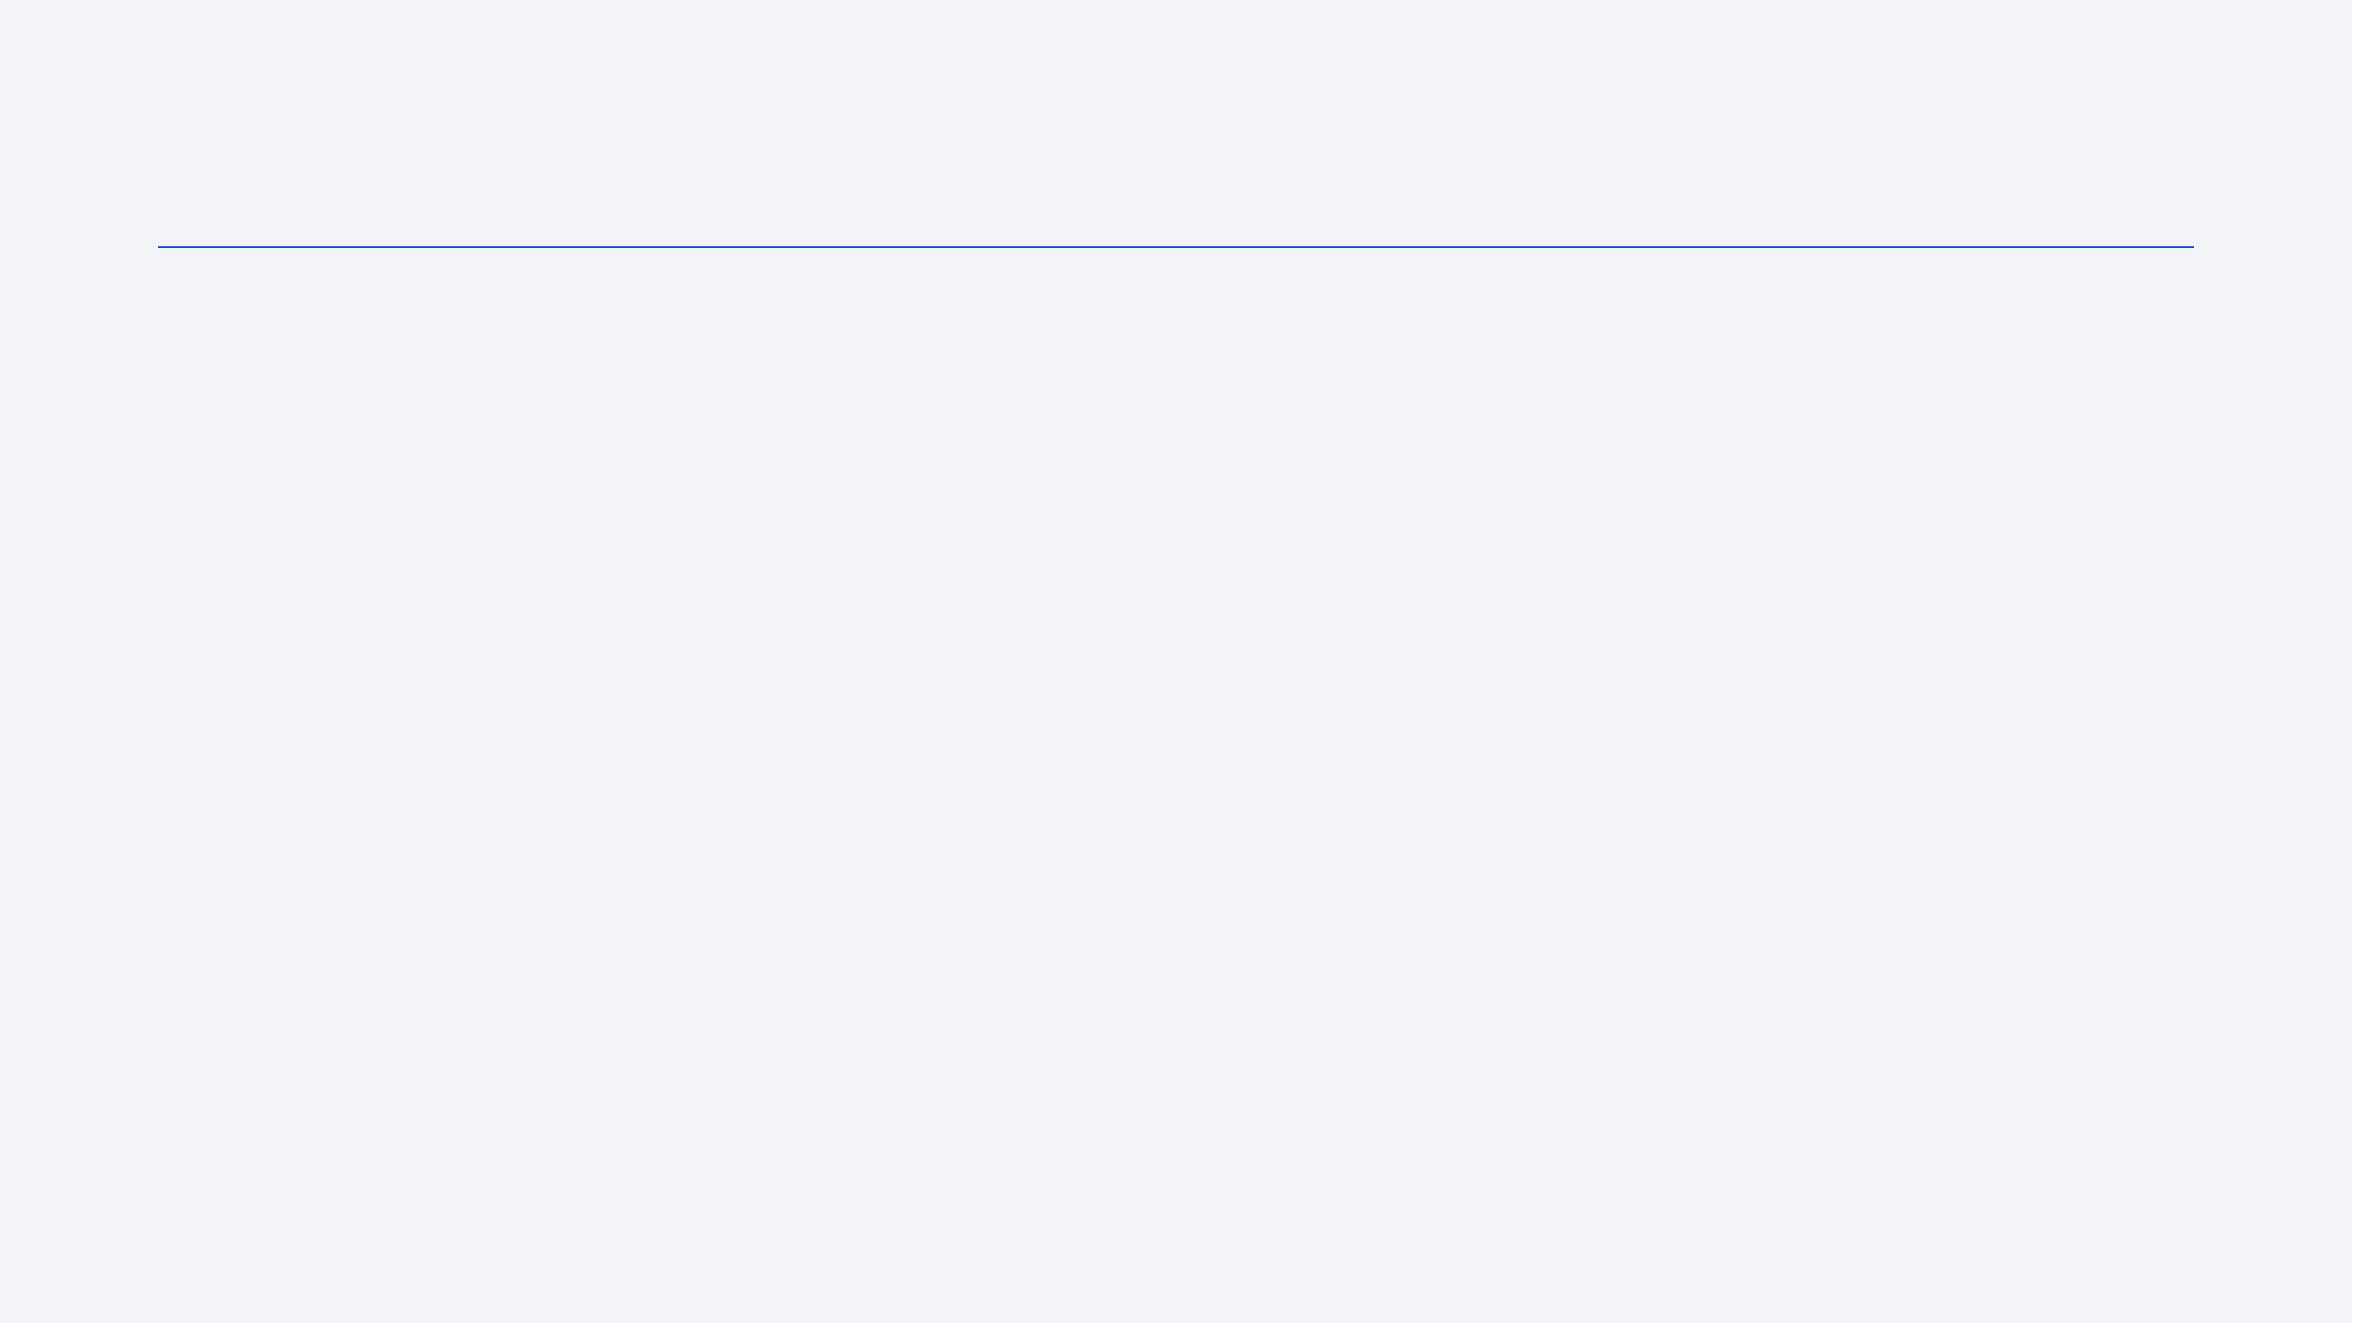
Outline
Executive Summary
Introduction
Methodology
Results
Conclusion
Appendix

Slide 3
Executive Summary
Summary of methodologies
a data-driven approach. Data was collected via SpaceX API and web scraping, then processed to create landing outcome variables. Exploratory analysis using SQL and visualizations revealed key patterns. Interactive Folium maps and Plotly dashboards highlighted relationships between launch sites, payloads, and success rates. Four machine learning models were tested, with Decision Trees achieving 94.4% accuracy in predicting outcomes. The study identified payload range (2000-6000kg) and equatorial launch sites as critical success factors, providing actionable insights for optimizing future SpaceX missions.
Summary of all results
SpaceX's launch success rates improved significantly over time, with equatorial launch sites proving most fuel-efficient. Coastal locations minimized collateral risks, while heavier payloads showed higher success rates. Certain orbit types demonstrated better performance, and Decision Tree modeling effectively predicted outcomes (94.4% accuracy). These findings optimize future missions for cost-efficiency and reliability.

Slide 4
Introduction
Background
Founded in 2002 by Elon Musk, SpaceX revolutionized space travel through reusable Falcon 9 rockets, slashing launch costs by 55% (from $150M to $67M). By analyzing landing success factors—like payload mass and launch location—this research aims to boost reliability, further reducing costs and advancing Musk’s vision of affordable space exploration.
Problems
Has there been a measurable improvement in Falcon 9 launch success rates throughout its operational history?
Success Determinants: Which operational and environmental factors most significantly influence landing success outcomes?
Prediction Methods: Which machine learning models demonstrate the highest accuracy in forecasting successful landings?

Slide 5

Section 1

Slide 6
Methodology
Executive Summary
Data collection methodology:
Gathered Falcon 9 launch data through SpaceX's API and Wikipedia scraping, compiling it into an analysis-ready dataset.
Perform data wrangling
Performed data preprocessing including missing value imputation, one-hot encoding of categorical features, and generation of a binary landing outcome label.
Perform exploratory data analysis (EDA) using visualization and SQL
Perform interactive visual analytics using Folium and Plotly Dash
Perform predictive analysis using classification models
Implemented model training by splitting data into train/test sets, developing four classifiers, making predictions, and evaluating performance through confusion matrices and accuracy metrics.

Slide 7
Data Collection
• Data Collection Methods for Falcon 9 Launches & Landings:
Method 1: SpaceX REST API
Retrieves structured JSON data directly from SpaceX's official API
Method 2: Web Scraping
Extracts launch records from HTML tables on Wikipedia pages

Slide 8
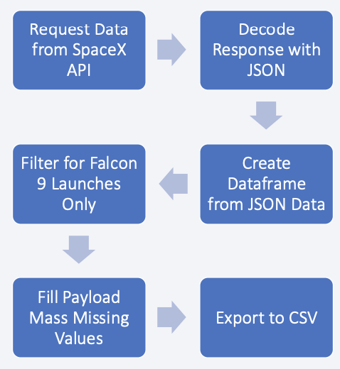
Data Collection – SpaceX API
https://github.com/lydiaxinyue

Slide 9
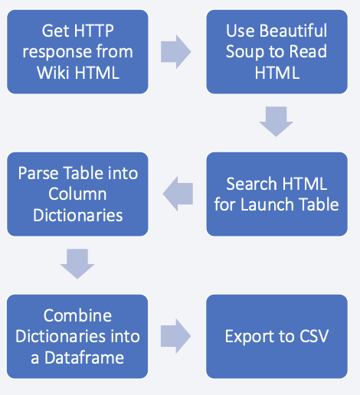
Data Collection - Scraping
https://github.com/lydiaxinyue

Slide 10
Data Wrangling
Detected nulls and variable types
Tabulated launches by key dimensions
Encoded outcomes as binary (1/0)
Calculated success percentages
Exported clean data to CSV
https://github.com/lydiaxinyue

Slide 11
EDA with Data Visualization
Reasoning:
• Scatter plots reveal relationships between variables to inform machine learning feature selection
• Bar charts visualize how categorical variables (like launch site) correlate with landing success
• Line charts track changes in success rates and other metrics over time
https://github.com/lydiaxinyue

Slide 12
EDA with SQL
Distinct launch locations
First 5 launch records from sites starting with "CCA"
Total payload weight for NASA missions
Mean payload capacity of Falcon 9 v1.1 boosters
Initial date of successful ground-based landing
Boosters with payloads 4000-6000 kg that achieved drone ship landings
Count of successful vs. failed missions
Booster models with maximum payload capacity
2015 drone ship landing failures by month
Ranked mission outcomes (06/04/2010–03/20/2017)
https://github.com/lydiaxinyue

Slide 13
Build an Interactive Map with Folium
• Orange circles placed on all launch site areas using its name and coordinates
• Colored info marker clusters added to each site with:
Green = Successful mission
Red = Failed mission
• Distance lines in KM added to show CCAFSLC-40 distances from nearest city, railway, highway, and coastline

Slide 14
Build a Dashboard with Plotly Dash
Launch Site Selection Menu
Dynamic visualization of all sites or individual site data
Mission Outcome Pie Charts
Displays success/failure percentages per selected launch site
Payload-Success Correlation Plot
Scatter points color-coded by booster variant
Interactive slider for payload mass filtering

Slide 15
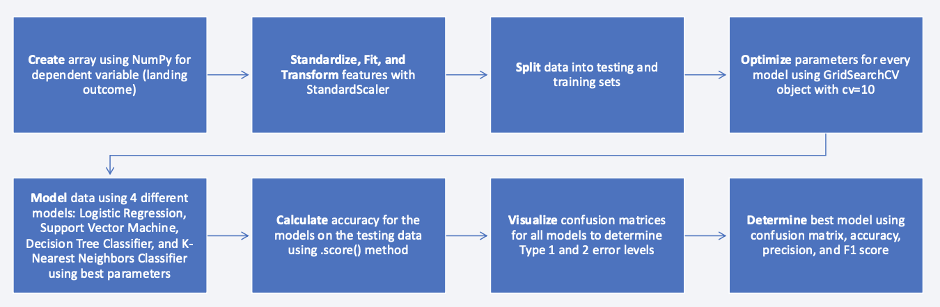
Predictive Analysis (Classification)
https://github.com/lydiaxinyue

Slide 16
Results
Exploratory data analysis results
Identified optimal payload range (4000–6000 kg) with highest success probability
Interactive analytics demo in screenshots
Real-time filtering by launch site and payload parameters
Predictive analysis results
Evaluated four classifiers: Logistic Regression, SVM, Decision Trees, KNN
SVM emerged as top performer post hyperparameter tuning (GridSearchCV)

Slide 17

Section 2

Slide 18
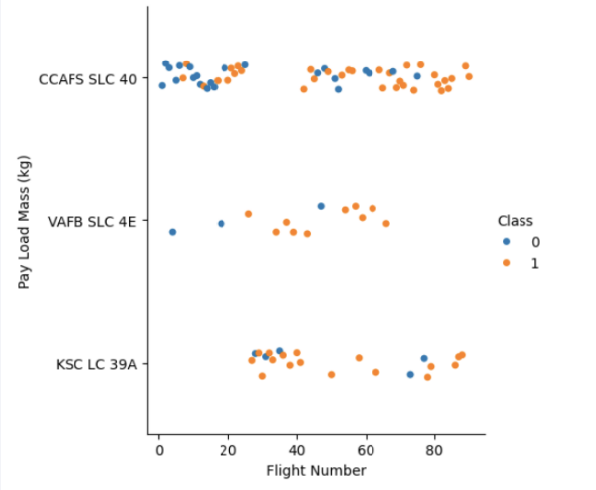
Flight Number vs. Launch Site
Visualizes the relationship between flight sequence and payload weight across three launch sites
Color-coded by mission outcome (Class 1=success/orange, Class 0=failure/blue)
Sites CCAFS SLC 40 and KSC LC 39A show higher success rates (dominant orange clusters)
Success frequency increases with later flight numbers
Identifies optimal launch sites and payload ranges for mission success

Slide 19
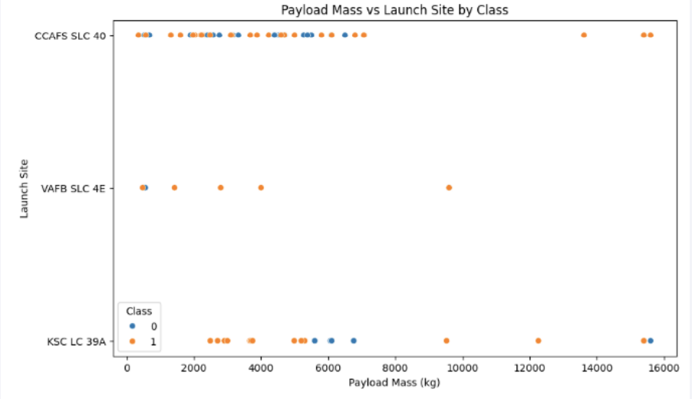
Payload vs. Launch Site
2000-6000 kg demonstrates highest mission success rates, indicating this mass window is ideal for reliable operations
CCAFS SLC 40 shows consistent success across diverse payload masses, suggesting either superior operational reliability or higher utilization frequency

Slide 20
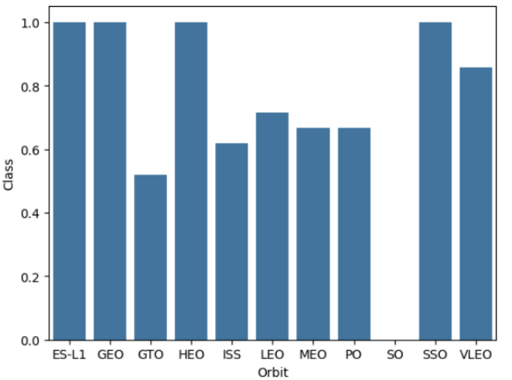
Success Rate vs. Orbit Type
GEO, SSO, HEO, and ES-L1 demonstrate 100% or near-perfect success rates, confirming their operational reliability
GTO and ISS missions show reduced success rates, potentially due to:
Complex orbital insertion requirements
Increased gravitational/variable challenges

Slide 21
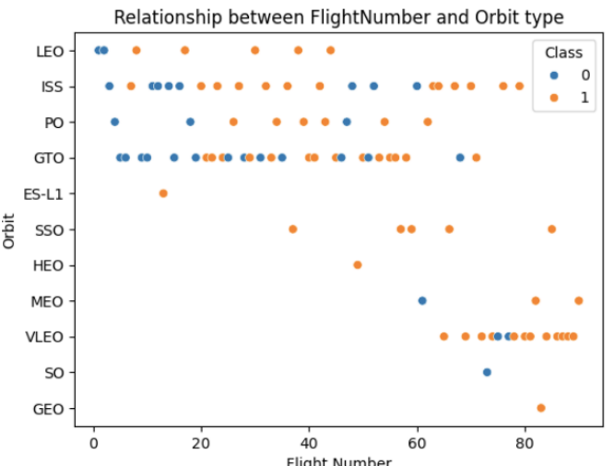
Flight Number vs. Orbit Type
Later flight numbers show dominant orange (success) across orbits, proving reliability improvements over time
Orbits like LEO/SSO/GTO exhibit both high utilization and success growth, reflecting SpaceX’s expertise

Slide 22
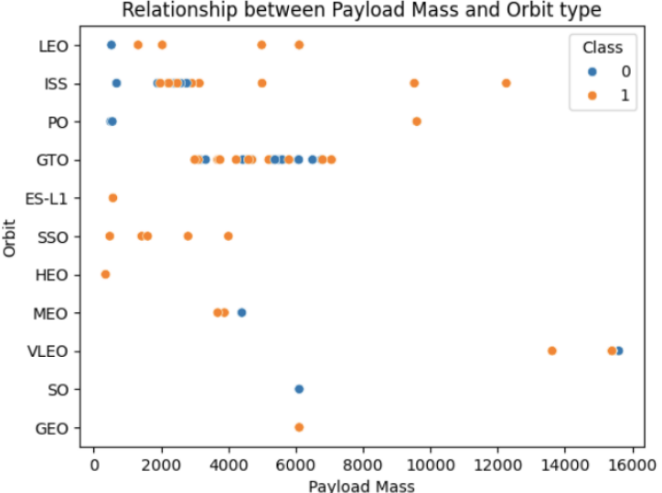
Payload vs. Orbit Type
GTO, LEO, and SSO orbits with 2000-6000 kg payloads demonstrate the highest success concentration, confirming this as the reliability sweet spot
Payloads exceeding 10,000 kg exhibit inconsistent results, suggesting weight-related operational challenges

Slide 23
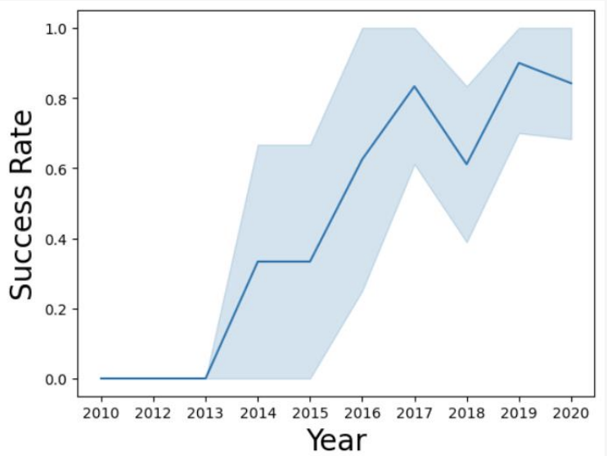
Launch Success Yearly Trend
Success rates have risen steadily since 2013, with accelerated growth during 2015-2017, demonstrating SpaceX's advancing technical capabilities
While experiencing occasional fluctuations, the long-term trend shows unmistakable reliability gains, reaching highest levels circa 2019

Slide 24
All Launch Site Names
Launch Site:
CCAFS LC-40
VAFB SLC-4E
KSC LC-39A
CCAFS SLC-40

Slide 25
Launch Site Names Begin with 'CCA'
Launch Site:
CCAFS LC-40
VAFB SLC-4E
KSC LC-39A
CCAFS SLC-40

Slide 26
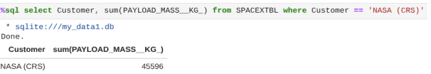
Total Payload Mass
Total NASA (CRS) Payload Mass = 45596KG

Slide 27
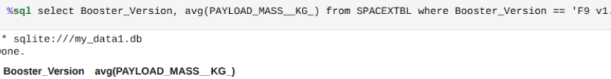
Average Payload Mass by F9 v1.1
Average F9v1.1 Booster Payload Mass = 2928.4KG

Slide 28
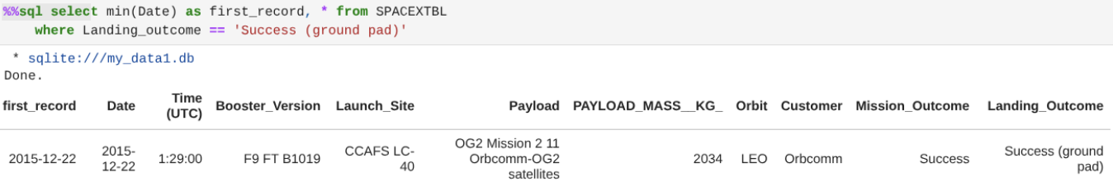
First Successful Ground Landing Date
This query fetches all data columns and the earliest launch date (MIN(Date)) from the SPACEXTABLE where Landing_Outcome starts with 'Success', pinpointing the first successful landing in the dataset.
Earliest Ground Pad Landing Success Date: 12-22-2015

Slide 29
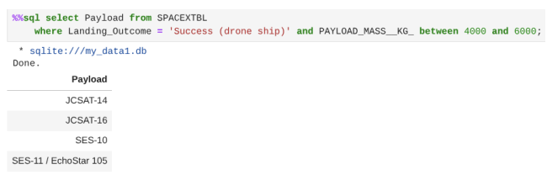
Successful Drone Ship Landing with Payload between 4000 and 6000
This SQL query identifies which booster versions successfully landed on drone ships while carrying medium-weight payloads (4000-6000 kg), revealing the most reliable hardware for this mission profile.
Payloads that matched criteria:
• JCSAT-14
• JCSAT-16
• SES-10
• SES-11 / EchoStar105

Slide 30
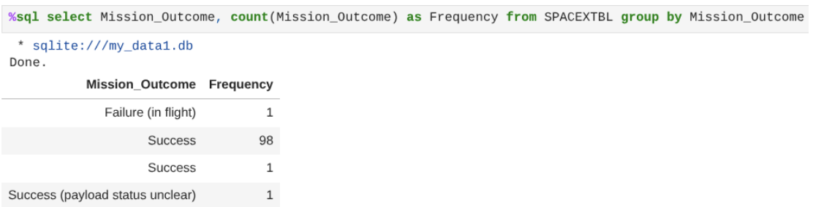
Total Number of Successful and Failure Mission Outcomes
This SQL query calculates the frequency of each distinct mission outcome in the SPACEXTABLE, generating a breakdown of successful versus failed missions to evaluate SpaceX's overall launch reliability.
Total Success Counts:
• 99 Successes
• 1 Success with payload status unclear
• 1 Failure

Slide 31
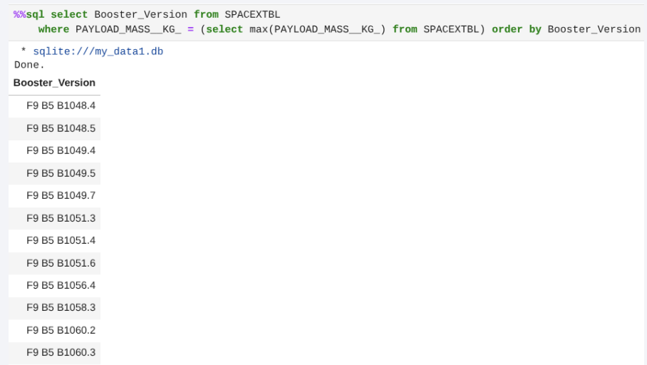
Boosters Carried Maximum Payload
This SQL query finds which booster version carried the heaviest payload by selecting all records with the maximum PAYLOAD_MASS__KG_ value in the dataset.
Max Payload Boosters:
• F9 B5
o B1048.4
o B1048.5
o B1049.4
o B1049.5
o B1049.7
o B1051.3
o B1051.4
o B1051.6
o B1056.4
o B1058.3
o B1060.2
o B1060.3

Slide 32
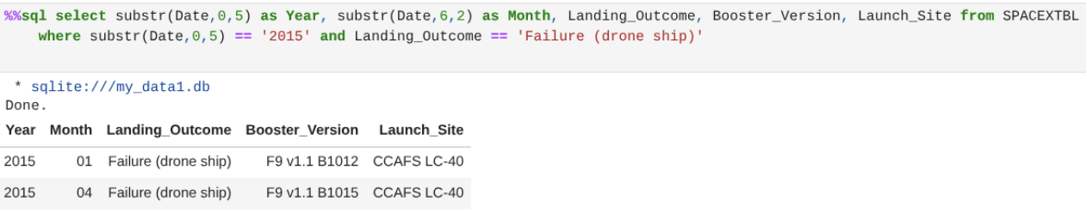
2015 Launch Records
This SQL query extracts the month, landing result, booster model, and launch location for all failed drone ship landings during 2015, enabling analysis of recurring failure factors in that mission type throughout the year.

Slide 33
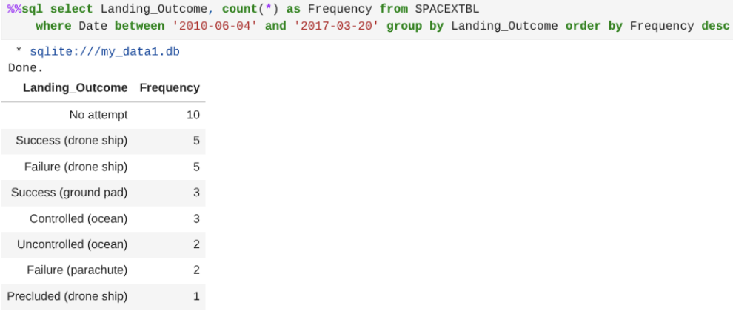
Rank Landing Outcomes Between 2010-06-04 and 2017-03-20

Slide 34

Section 3

Slide 35
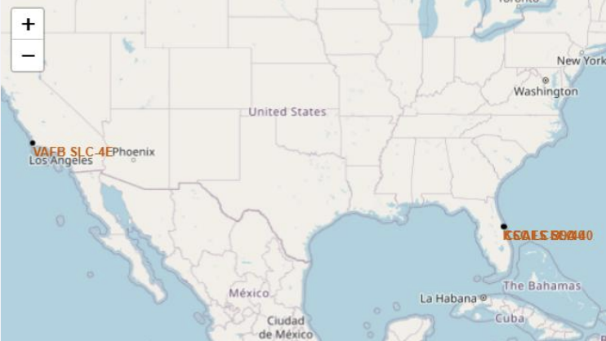
All launch sites on a map
The map visualizes SpaceX's U.S. launch sites with labeled markers: VAFB SLC-4E in California (West Coast) and KSC LC-39A/CCAFS SLC-40 in Florida (East Coast), demonstrating strategic geographic distribution that enables both polar and equatorial orbit missions while optimizing orbital access flexibility and mission planning efficiency.

Slide 36
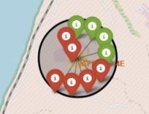
Success and failed launches for each site
The initial map employs clustered circle markers to visualize launch frequency, clearly demonstrating Florida's CCAFS and KSC facilities managed substantially higher mission volumes than California's VAFB. The subsequent map conducts proximity analysis for VAFB SLC-4E, plotting surrounding infrastructure like transport routes and structures to evaluate operational safety and logistical considerations through geospatial relationships.

Slide 37
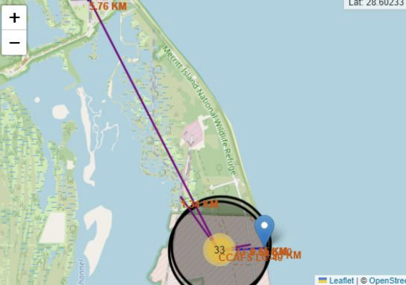
Distances between launch site and its proximities
This map precisely measures and displays distances between CCAFS SLC-40 and surrounding geographic features - including shorelines and populated areas - verifying its safety buffer zones. The spatial analysis validates the launch site's strategic placement, demonstrating how its isolation minimizes risks to both environment and nearby infrastructure while meeting operational requirements.

Slide 38

Section 4

Slide 39
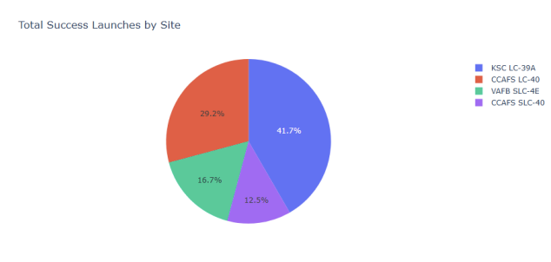
Total Success Launches by Site
The pie chart demonstrates KSC LC-39A's operational dominance with a 40% success rate contribution, while the remaining success distribution among CCAFS LC-40, VAFB SLC-4E, and CCAFS SLC-40 reveals concentrated reliability at select facilities despite multiple active launch sites.

Slide 40
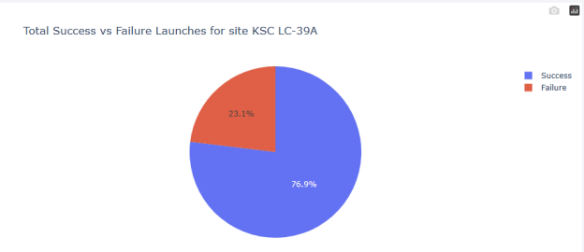
Total launches for site KSC LC-39A
KSC LC-39A demonstrates exceptional reliability with a 77% launch success rate, solidifying its status as SpaceX's premier launch facility. The modest 23% failure rate reflects both the site's operational expertise and advantageous geographic conditions for mission success.

Slide 41
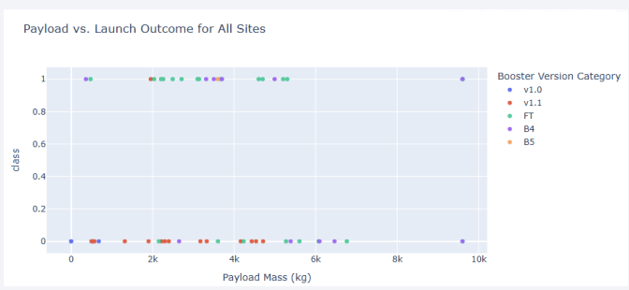
Payload vs Launch Outcomes for All Sites
Optimal Payload Range: Missions carrying 2000–6000 kgdemonstrate peak success rates, particularly when flown on FT, B4, and B5 boosters, confirming their reliability.
Booster Evolution: Older models (v1.0, v1.1) show higher failure rates, while newer iterations (FT/B5) prove significantly more dependable, reflecting SpaceX’s engineering advancements.

Slide 42

Section 5

Slide 43
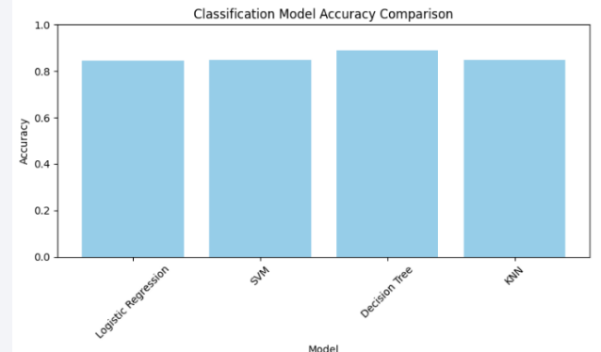
Classification Accuracy
Decision Tree has the highest classification accuracy

Slide 44
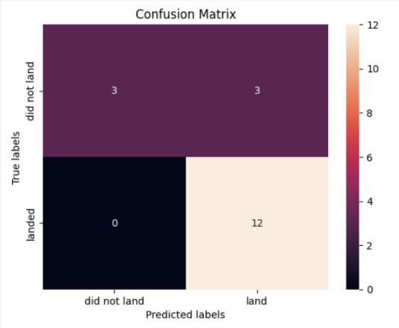
Confusion Matrix
Accurate Predictions: Correctly identified 12 successful landings and 3 failed landings with zero missed detections (no false negatives).
Minor Errors: Generated 3 false positives (incorrectly predicting landings that failed).
Key Strength: Demonstrates high recall (100%) and strong precision for landing success, proving exceptional reliability in validating viable landings.

Slide 45
Conclusions
Integrated SpaceX API, Wikipedia scraping, and SQL databases to compile comprehensive launch records.
Cleaned and merged multi-source datasets to ensure structured, analysis-ready inputs.
2000–6000 kg range correlated with highest success rates.
KSC LC-39A and CCAFS SLC-40 demonstrated superior reliability and activity.
SSO and HEO orbits achieved near-perfect success rates.
Interactive dashboards enabled real-time filtering by payload and launch site, enhancing trend discovery.
SVM outperformed other classifiers, with confusion matrix results showing:
100% recall (no missed landings)
High precision (minimal false positives)

Slide 46


